Slide 1
Oracle PL/SQL

Slide 2
PL/SQL
Originally modeled after ADA
  Created for Dept. of Defense
Allows expanded functionality of database applications
Continues to improve with each new database release

Slide 3
PL/SQL
Features
  Tight integration with SQL
    Supports data types, functions, pseudo-columns, etc.
  Increased performance
    A block of statements sent as a single statement
  Increased productivity
    Same techniques can be used with most Oracle products
  Portability
    Works on any Oracle platform
  Tighter security
    Users may access database objects without granted privileges

Slide 4
PL/SQL Programs
Declaration section (optional)
  Any needed variables declared here
Executable or begin section
  Program code such as statements to retrieve or manipulate data in a table
Exception section (optional)
  Error traps can catch situations which might ordinarily crash the program

Slide 5
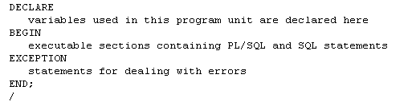
PL/SQL Block Structure

Slide 6
PL/SQL Variables
Variables are local to the code block
Names can be up to 30 characters long and must begin with a character
Declaration is like that in a table
  Name then data type the semi-colon
  Can be initialized using := operator in the declaration
  Can be changed with := in the begin section
  Can use constraints
Variables can be composite or collection types
  Multiple values of different or same type

Slide 7
Common PL/SQL Data Types
  CHAR ( max_length )
  VARCHAR2 ( max_length )
  NUMBER ( precision, scale )
  BINARY_INTEGER – more efficient than number
  RAW ( max_length )
  DATE
  BOOLEAN (true, false, null)
  Also LONG, LONG RAW and LOB types but the capacity is usually less in PL/SQL than SQL

Slide 8
PL/SQL Variable Constraints
NOT NULL
  Can not be empty
CONSTANT
  Can not be changed

Slide 9
PL/SQL Variables Examples
Age number;
Last char ( 10 );
DVal Date := Sysdate;
SID number not null;
Adjust constant number := 1;
CanLoop boolean := true

Slide 10
Predefined Exceptions
INVALID_NUMBER (ORA-01722)
  Attempted to store non-numeric data in a variable with a numeric data type
NO_DATA_FOUND (ORA-01403)
  Query resulted in no rows being found
NOT_LOGGED_ON (ORA-01012)
  Not currently connected to an Oracle database
TOO_MANY_ROWS (ORA-01422)
  A SELECT INTO statement returned more than one row

Slide 11
Predefined Exceptions (cont.)
DUP_VALUE_ON_INDEX (ORA-00001)
  Value inserted for a primary key is not unique
VALUE_ERROR (ORA-06502)
  The value being placed in a variable is the wrong length or data type
ZERO_DIVIDE (ORA-01476)
  An attempt was made to divide a number by zero

Slide 12
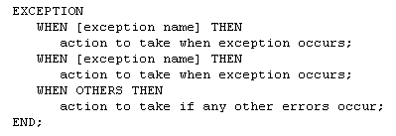
Structure of Exception Section

Slide 13
Conditional Structures
IF-THEN
IF-THEN-ELSE
IF-THEN-ELSIF
  An alternative to nested IF-THEN_ELSE

Slide 14

IF-THEN Structure

Slide 15

IF-THEN-ELSE Structure

Slide 16
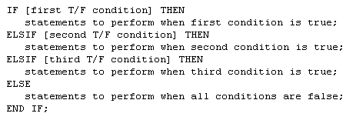
IF-THEN-ELSIF Structure

Slide 17
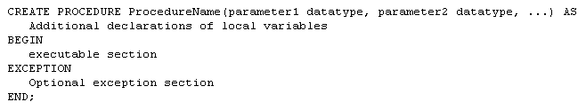
Stored Procedures

Slide 18
Stored Procedures
The first line is called the Procedure Specification
The remainder is the Procedure Body
A procedure is compiled and loaded in the database as an object
Procedures can have parameters passed to them

Slide 19
Stored Procedures
Run a procedure with the PL/SQL EXECUTE command
Parameters are enclosed in parentheses

Slide 20
Stored Functions
Like a procedure except they return a single value

Slide 21
Triggers
Associated with a particular table
Automatically executed when a particular event occurs
  Insert
  Update
  Delete
  Others

Slide 22
Triggers vs. Procedures
Procedures are explicitly executed by a user or application
Triggers are implicitly executed (fired) when the triggering event occurs
Triggers should not be used as a lazy way to invoke a procedure as they are fired every time the event occurs

Slide 23
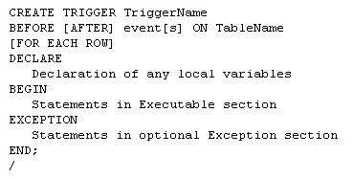
Triggers

Slide 24
Triggers
The trigger specification names the trigger and indicates when it will fire
The trigger body contains the PL/SQL code to accomplish whatever task(s) need to be performed

Slide 25
Triggers

Slide 26
Triggers Timing
A triggers timing has to be specified first
  Before (most common)
    Trigger should be fired before the operation
      i.e. before an insert
  After
    Trigger should be fired after the operation
      i.e. after a delete is performed

Slide 27
Trigger Events
Three types of events are available
  DML events
  DDL events
  Database events

Slide 28
DML Events
Changes to data in a table
  Insert
  Update
  Delete

Slide 29
DDL Events
Changes to the definition of objects
  Tables
  Indexes
  Procedures
  Functions
  Others
    Include CREATE, ALTER and DROP statements on these objects

Slide 30
Database Events
Server Errors
Users Log On or Off
Database Started or Stopped

Slide 31
Trigger DML Events
Can specify one or more events in the specification
  i.e. INSERT OR UPDATE OR DELETE
Can specify one or more columns to be associated with a type of event
  i.e. BEFORE UPDATE OF SID OR SNAME

Slide 32
Table Name
The next item in the trigger is the name of the table to be affected

Slide 33
Trigger Level
Two levels for Triggers
  Row-level trigger
    Requires FOR EACH ROW clause
      If operation affects multiple rows, trigger fires once for each row affected
  Statement-level trigger
  DML triggers should be row-level
  DDL and Database triggers should not be row-level

Slide 34
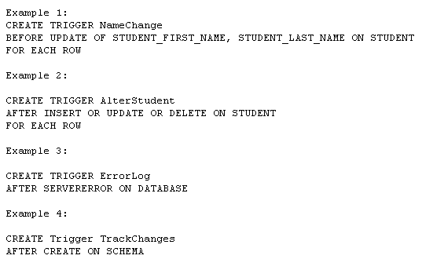
Event Examples

Slide 35
Triggers
Conditions Available So Multiple Operations Can Be Dealt With In Same Trigger
  Inserting, Updating, Deleting
Column Prefixes Allow Identification Of Value Changes
  New, Old

Slide 36
Triggers Exceptions
EXCEPTION Data Type Allows Custom Exceptions
RAISE Allows An Exception To Be Manually Occur
RAISE_APPLICATION_ERROR Allows Termination Using A Custom Error Message
  Must Be Between -20000 and -20999
  Message Can Be Up to 512 Bytes

Slide 37
Cursors
Cursors Hold Result of an SQL Statement
Two Types of Cursors in PL/SQL
  Implicit – Automatically Created When a Query or Manipulation is for a Single Row
  Explicit – Must Be Declared by the User
    Creates a Unit of Storage Called a Result Set

Slide 38
Cursors
Result Set
MIS380 DATABASE DESIGN 4
MIS202 INFORMATION SYSTEMS 3 <Cursor
MIS485 MANAGING TECHNOLOGY 4
MIS480 ADVANCED DATABASE 4

Slide 39
Cursors
Declaring an Explicit Cursor
CURSOR CursorName IS SelectStatement;
Opening an Explicit Cursor
OPEN CursorName;
Accessing Rows from an Explicit Cursor
FETCH CursorName INTO RowVariables;

Slide 40
Cursors
Declaring Variables of the Proper Type with %TYPE
VarName TableName.FieldName%TYPE;
Declaring Variables to Hold An Entire Row
VarName CursorName%ROWTYPE;
Releasing the Storage Area Used by an Explicit Cursor
CLOSE CursorName;

Slide 41
Iterative Structures
LOOP … EXIT … END LOOP
  EXIT with an If Avoids Infinite Loop
LOOP … EXIT WHEN … END LOOP
  Do Not Need An If to Control EXIT
WHILE … LOOP … END LOOP
  Eliminates Need for EXIT
FOR … IN … END LOOP
  Eliminates Need for Initialization of Counter

Slide 42
Cursor Control With Loops
Need a Way to Fetch Repetitively
Need a Way to Determine How Many Rows to Process With a Cursor
  Cursor Attributes
    CursorName%ROWCOUNT – Number of Rows in a Result Set
    CursorName%FOUND – True if a Fetch Returns a Row
    CursorName%NOTFOUND – True if Fetch Goes Past Last Row

Slide 43
Cursor For Loop
Processing an Entire Result Set Common
Special Form of FOR … IN to Manage Cursors
No Need for Separate OPEN, FETCH and CLOSE statements
Requires %ROWTYPE Variable

